Slide 1
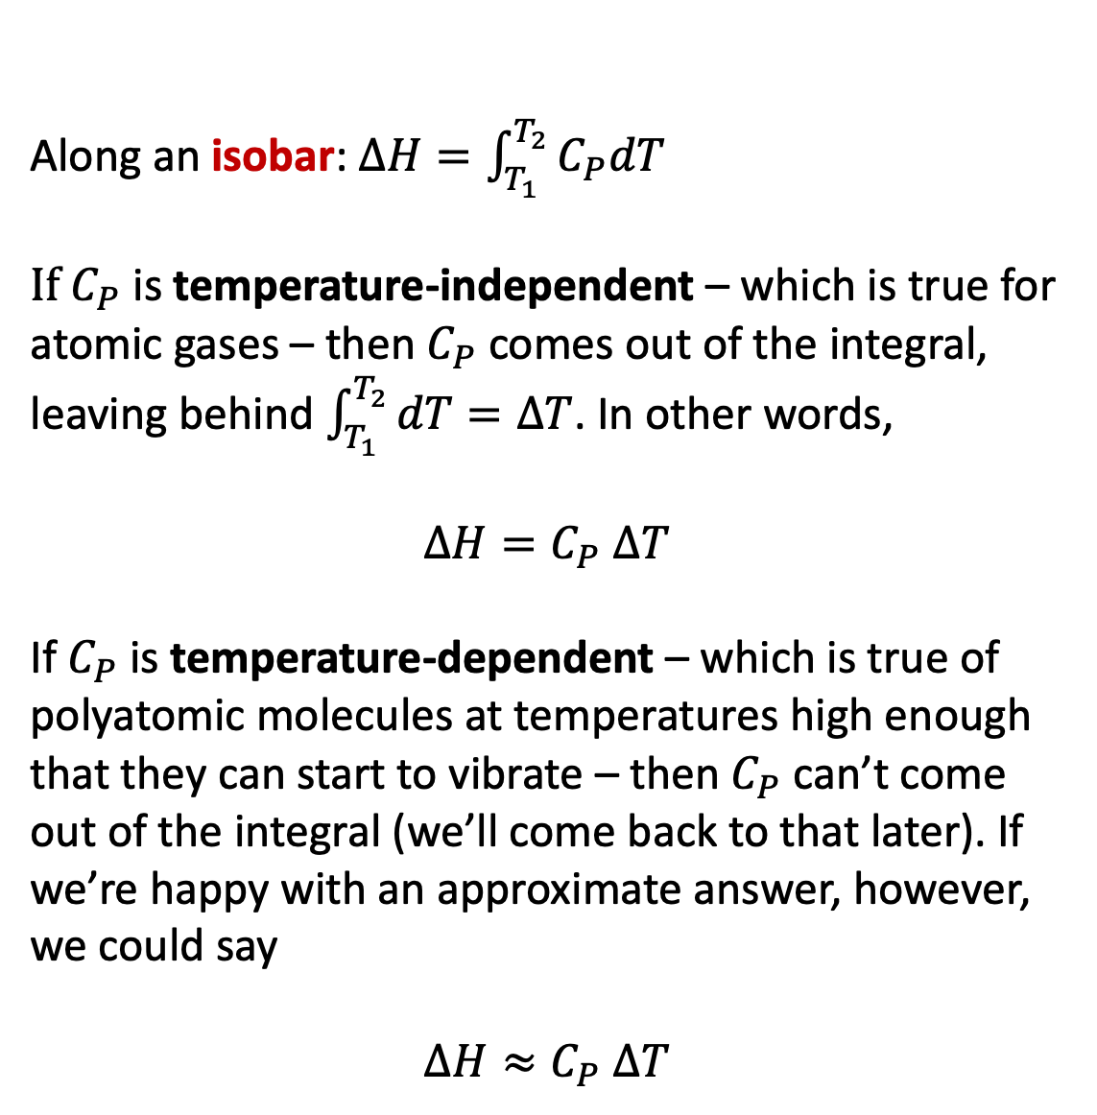



Finding changes in enthalpy ($∆H$) along an isobar
Along an isobar: $∆H=\int_{T_{1}}^{T_{2}}{C_{P}dT}$
If $C_{P}$ is temperature-independent – which is true for atomic gases – then $C_{P}$ comes out of the integral, leaving behind $\int_{T_{1}}^{T_{2}}{dT}=∆T$. In other words,
$∆H=C_{P}$ $∆T$
If $C_{P}$ is temperature-dependent – which is true of polyatomic molecules at temperatures high enough that they can start to vibrate – then $C_{P}$ can’t come out of the integral (we’ll come back to that later). If we’re happy with an approximate answer, however, we could say
$$∆H≈C_{P} ∆T$$
$$∆H$$
$$T_{2}$$
$$T_{1}$$

Slide 2
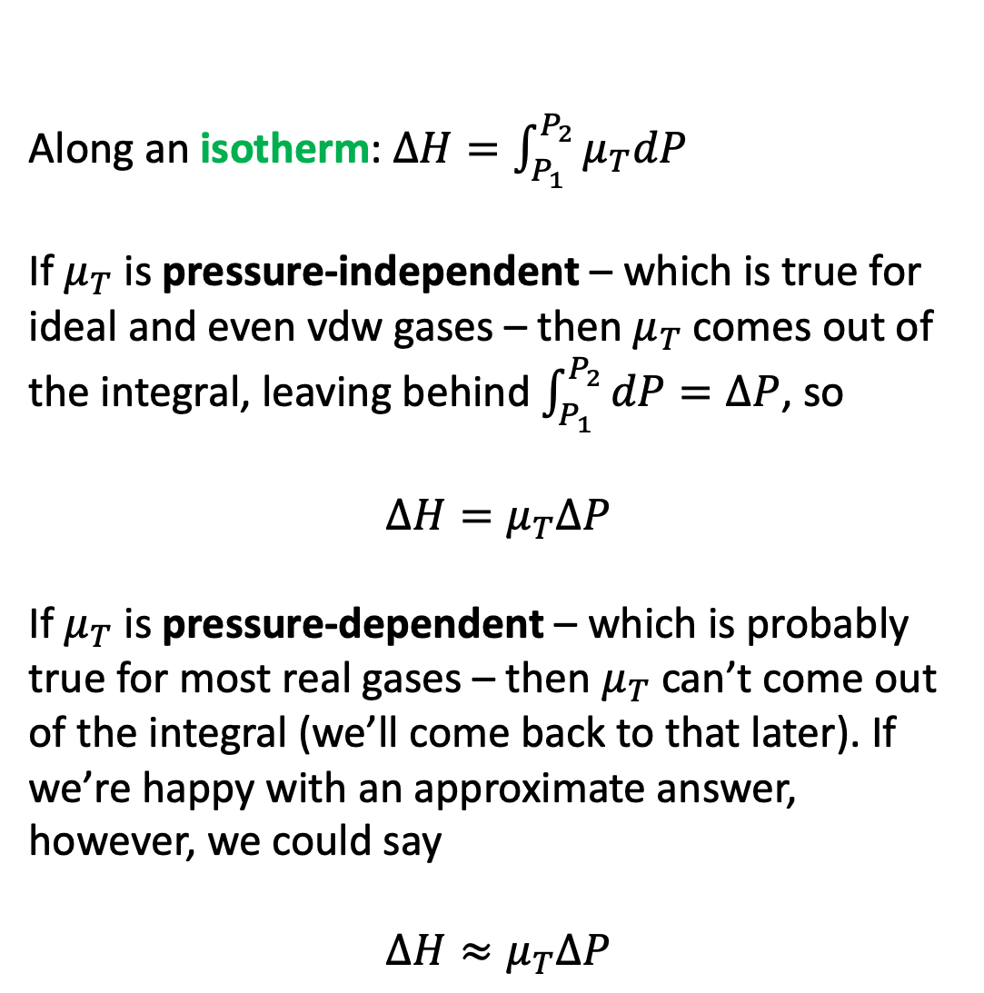



Finding changes in enthalpy ($∆H$) along an isotherm
Along an isotherm: $∆H=\int_{P_{1}}^{P_{2}}{μ_{T}dP}$
If $μ_{T}$ is pressure-independent – which is true for ideal and even vdw gases – then $μ_{T}$ comes out of the integral, leaving behind $\int_{P_{1}}^{P_{2}}{dP}=∆P$, so
$$∆H=μ_{T}∆P$$
If $μ_{T}$ is pressure-dependent – which is probably true for most real gases – then $μ_{T}$ can’t come out of the integral (we’ll come back to that later). If we’re happy with an approximate answer, however, we could say
$$∆H≈μ_{T}∆P$$
$$P_{1}$$
$$∆H$$
$$P_{2}$$

